Slide 1
Savvy Coders Class Project December 2023

Slide 2
Main Questions
1. Determine the current state and potential growth of the EV market in the U.S.:
- Is investment in EVs increasing? - How does the US compare to the rest of the world?
2. Identify key areas or regions where EV charging infrastructure is lacking or in high demand: - What State to invest in? Why? - What State to AVOID investing in? Why? - What city to invest in? Why? - What city to AVOID investing in? Why? - Other relevant geographical features

Slide 3

Python Cleaning

Slide 4

Continuing Python Cleaning

Slide 5

Continuing Python Cleaning

Slide 6


Continuing Python Cleaning

Slide 7

Continuing Python Cleaning

Slide 8


Continuing Python Cleaning

Slide 9


Continuing Python Cleaning

Slide 10

Result Through the SQL Statements

Slide 11
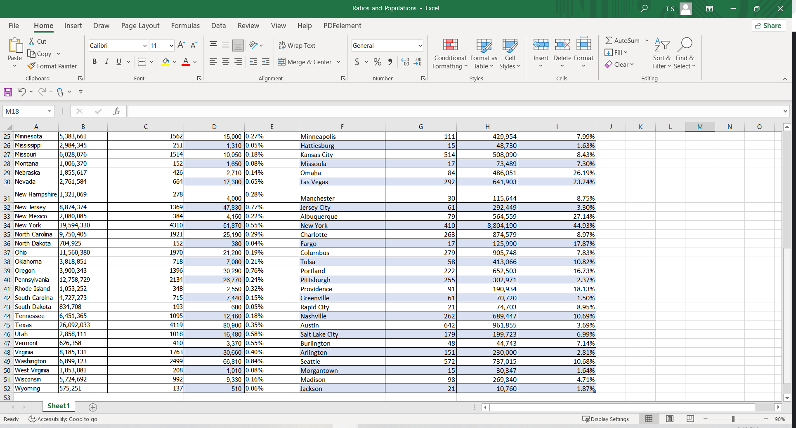
Result Through the SQL Statements

Slide 12
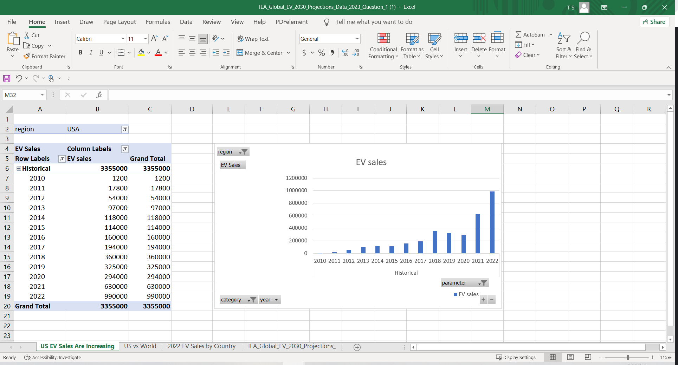
US EV SALEs ARE Increasing

Slide 13

US vs World
Global EV Sales: Increasing at a higher rate compared to the US.

Slide 14


2022 EV sales by country
China's Position: Leads in EV sales globally, with the USA following as the second-largest market.

Slide 15
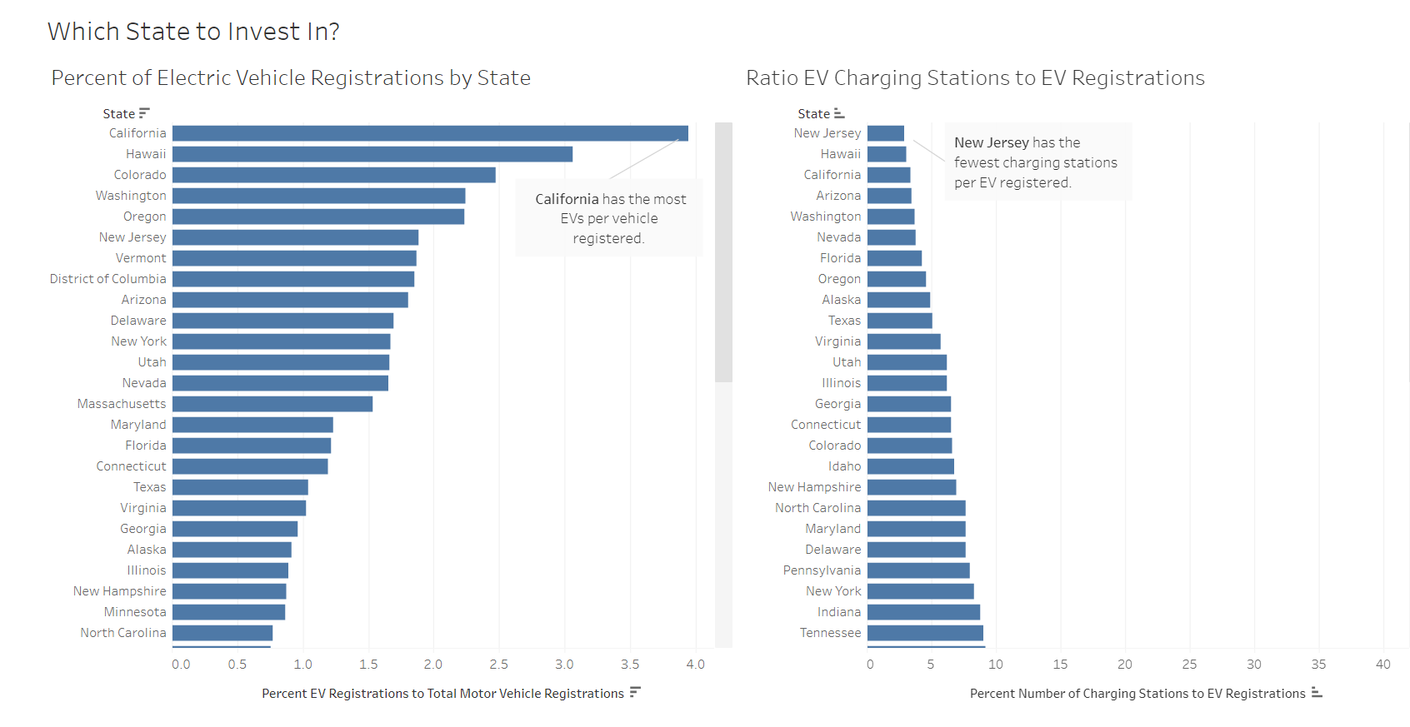
Tableau visualization

Slide 16
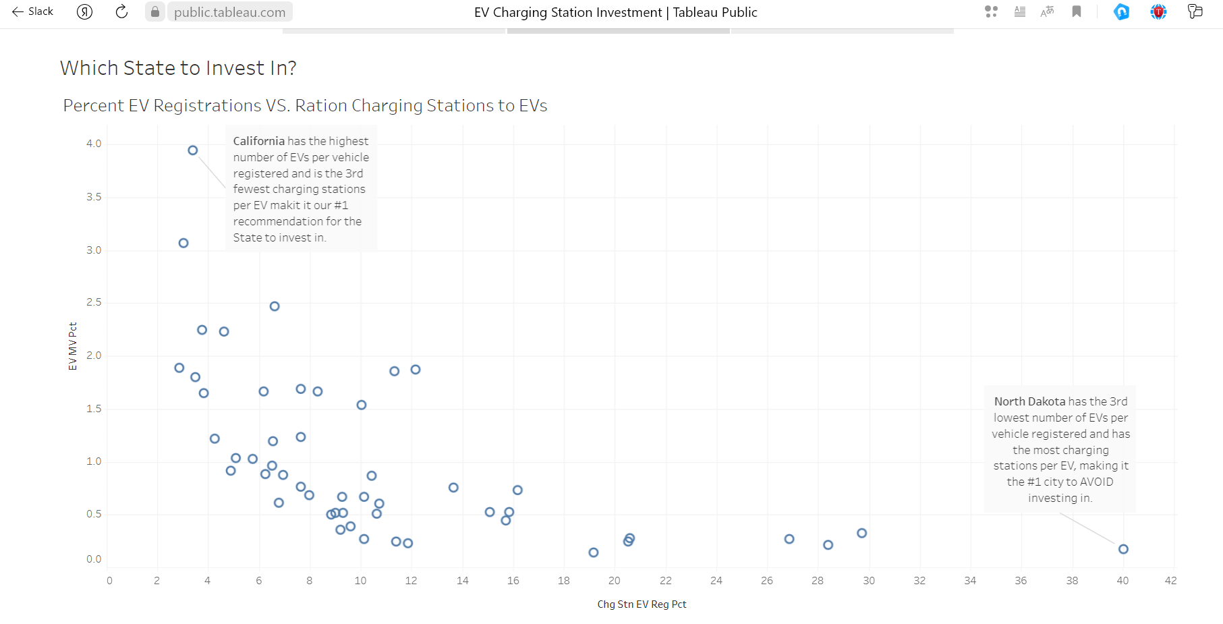

Slide 17
State-Level Analysis
California: Boasts the highest number of EVs per vehicle registered in the US.
New Jersey: Reports the fewest charging stations per EV.
California: Stands out as having both the highest number of EVs per vehicle registered and being among the fewest in charging stations per EV, making it a top recommendation for investment.
North Dakota: Shows the third-lowest number of EVs per vehicle registered and the highest number of charging stations per EV, indicating it's advisable to avoid investment.

Slide 18
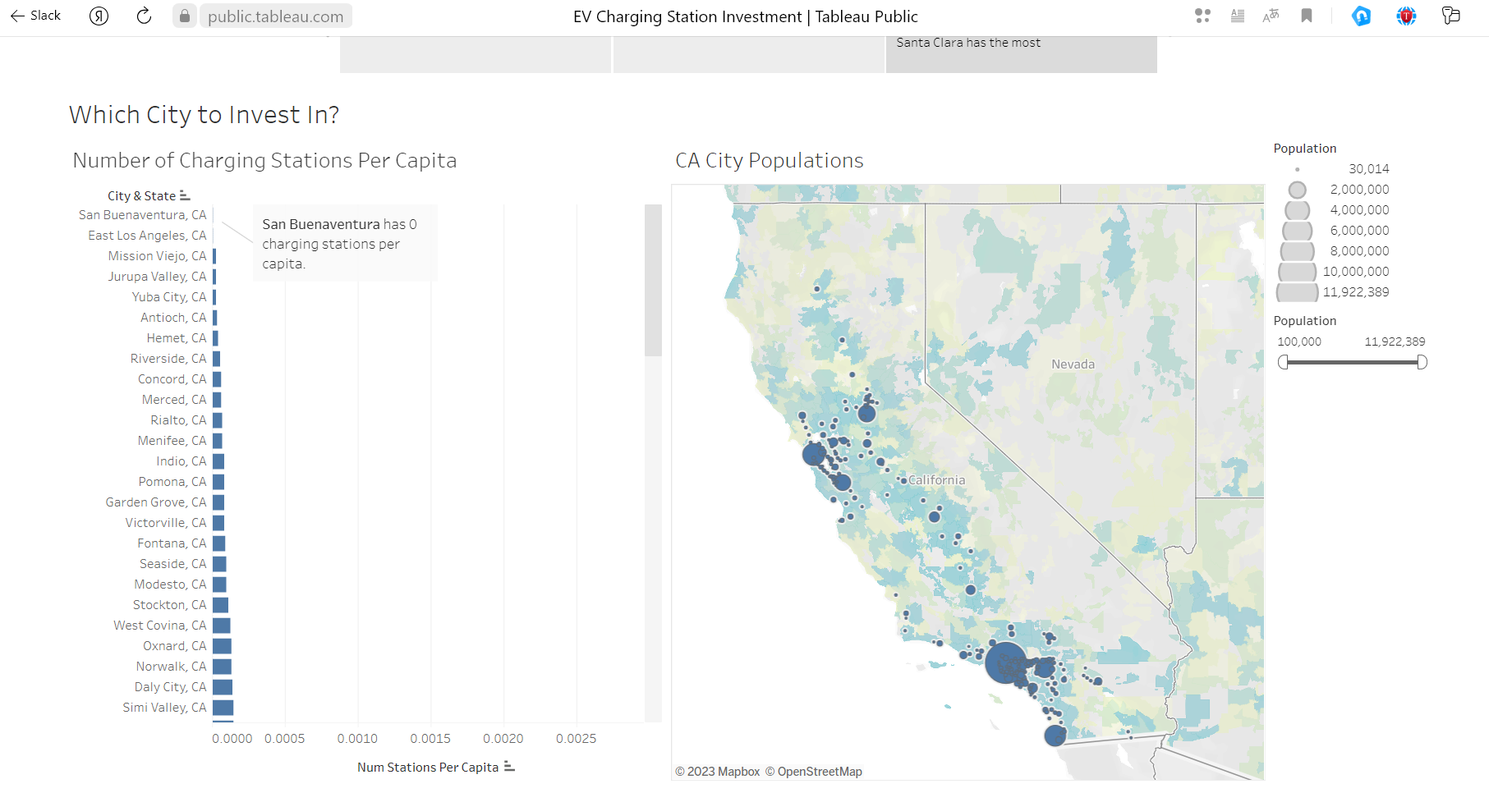

Slide 19
City-Level Analysis
California's Demand: Exhibits the highest demand considering both EVs per vehicle registered and charging stations per EV.
San Buenaventura: Reports zero charging stations per capita.
Santa Clara: Records the highest number of charging stations per capita.
San Buenaventura, CA: Among cities with populations over 100K, reports the fewest EV charging stations per capita.
Santa Clara: Leads in the number of charging stations per capita among cities with populations over 100K.

Slide 20
Conclusion
The analysis conducted on the EV market in the United States reveals dynamic trends and varying infrastructure scenarios across states and cities. While US EV sales are on the rise, the global market, particularly led by China, is growing at a faster pace. California emerges as a frontrunner with the highest EVs per vehicle registered, indicating its strong market penetration. However, disparities exist in charging infrastructure, with New Jersey having the fewest charging stations per EV and North Dakota presenting a different dynamic, making it advisable to avoid investment.
Recommendations
Investment Strategy:
State-level: California stands out as a prime state for investment due to its high EV adoption despite a comparatively lower number of charging stations per EV.
City-level: Santa Clara exhibits a robust charging infrastructure, while San Buenaventura faces a notable lack of charging stations per capita.
Next Steps
Charging Station Types:
Recommendation: Assess the demand in different regions to determine the most beneficial mix of charging station types (e.g., fast charging, standard charging) based on consumer needs and vehicle preferences.
Pricing and Rate Structures:
Recommendation: Conduct a pricing and rate structure analysis to optimize the charging station economics. Evaluate factors such as usage patterns, peak demand times, and regional variations to design sustainable and attractive pricing models for EV charging.
These next steps aim to further optimize the EV market infrastructure by tailoring charging station types and developing pricing structures that align with consumer needs while ensuring economic viability for stakeholders.

